Slide 1
Cells and their Organelles
7th Grade Science

Slide 2
Brain Pop
https://www.brainpop.com/health/bodysystems/cells/

Slide 3
What is a cell?
Using the information learned from the brain pop, create a definition for the word cell. Be prepared to present what you come up with. You may talk to the person next to you.

Slide 4
Cell Organelles or Cell Parts
Cell Organelles are the tiny working parts of a cell.
Each organelle or part is specialized for a function.
ALL cells have organelles.

Slide 5
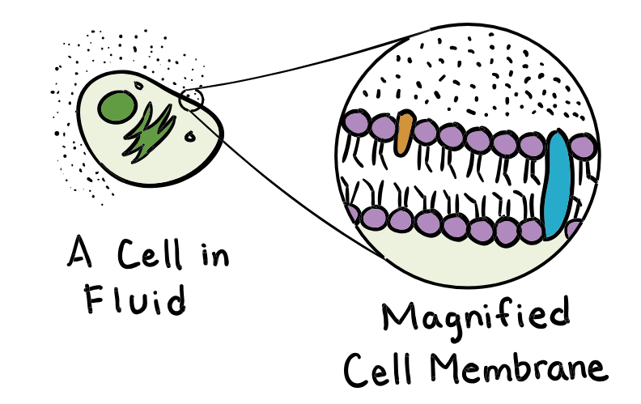
Cell Membrane
The cell membrane forms the outside of the cell and holds the cell together.
It controls what comes in and out of the cell.
EVERY cell has a cell membrane.

Slide 6
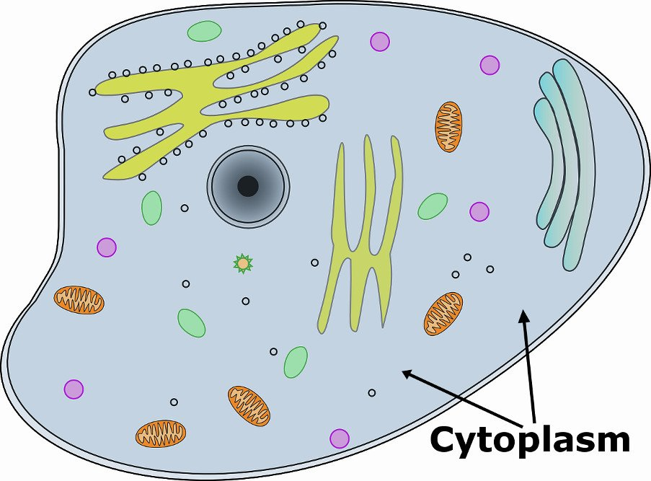
Cytoplasm
The cytoplasm is the jellylike substance inside the cell.
It holds all of the cell parts within the cell wall and allows movement within the cell.
EVERY cell has cytoplasm.

Slide 7
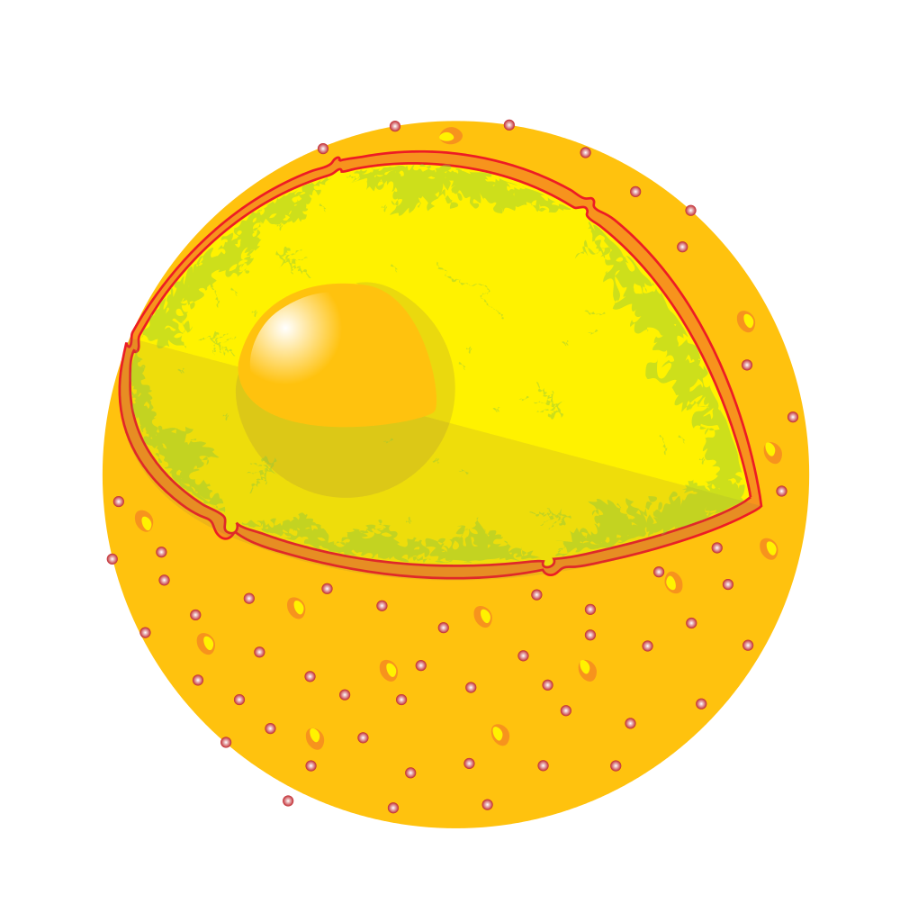
Nucleus
The nucleus is the control center of the cell. It is where the cell’s DNA is housed.
EVERY cell has a nucleus and a Nuclear Membrane.
Nuclear Membrane
The nuclear membrane is a protective membrane that surrounds the nucleus and controls what comes in and out of the nucleus.

Slide 8
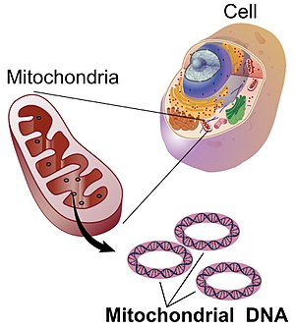
Mitochondria
The mitochondria are the cell’s powerhouse. They release energy in food by carrying out a reaction with oxygen.
Cells that need more energy will have a larger number of mitochondria.
They are in EVERY cell.

Slide 9
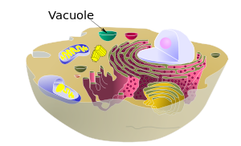
Vacuoles
Vacuoles are temporary storage bubbles for the cell.
They store water, food, and waste.
They are in EVERY cell, but plant cells have larger vacuoles.

Slide 10
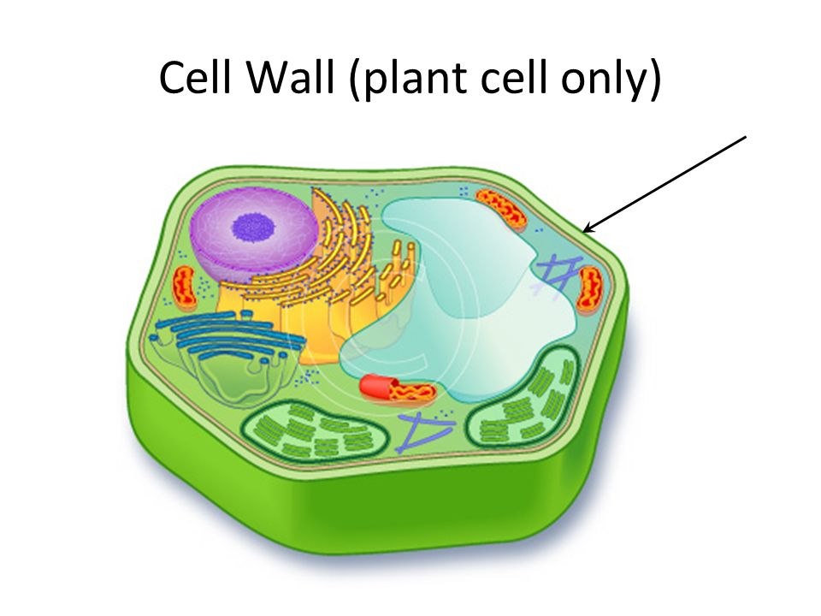
Cell Wall
The cell wall is the tough and rigid outer layer that protects the cell and gives it shape.
PLANT cells have a cell wall. Animal cells DO NOT have a cell wall.

Slide 11
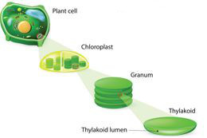
Chloroplasts
Chloroplasts are food production structures that contain chlorophyll. Chlorophyll is important for photosynthesis.
PLANT cells have chloroplasts. Animal cells DO NOT.

Slide 12
Lysosomes
Digest food particles, waste and foreign particles
Found in BOTH plant & animal cells

Slide 13
Ribosomes
Where proteins are made in the cell
Found in both animal and plant cells

Slide 14
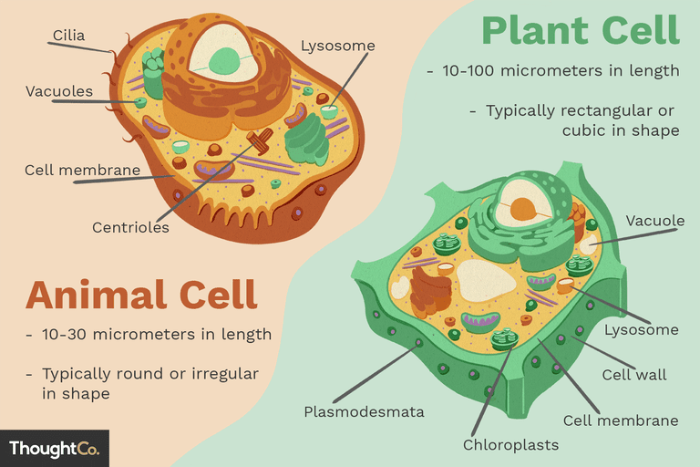
Plant Cell VS Animal Cell Color Sheet

