Slide 1
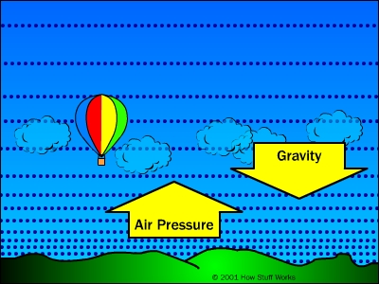
Air Pressure
Can you feel it?
Notes:
1

Slide 2
Air Pressure Video
https://www.youtube.com/watch?v=pHrCSuiz3c0&t=1s

Slide 3
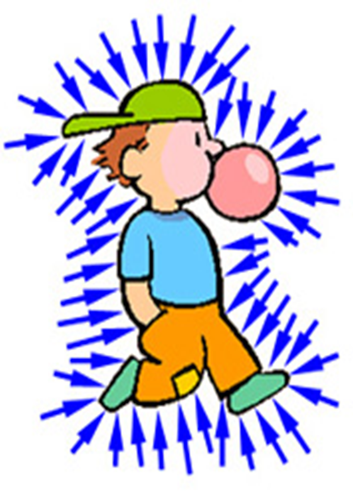
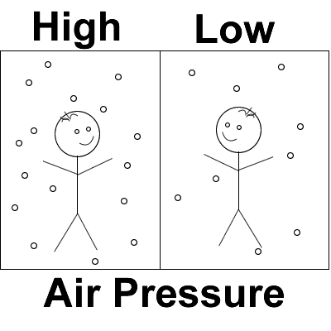
Air Pressure
Air pressure is the force of air molecules pushing on an area.
Air Pressure is GREATEST at the surface of Earth because there is more of the atmosphere above you to push down on you.
The greater the force, the higher the air pressure.
Air molecules move in all directions, so air pressure pushes in all directions.
Notes:
3

Slide 4
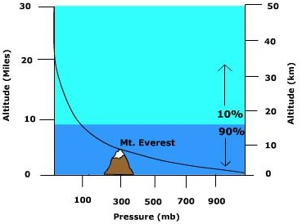
As you move UP through the atmosphere, air pressure decreases.
Notes:
4

Slide 5
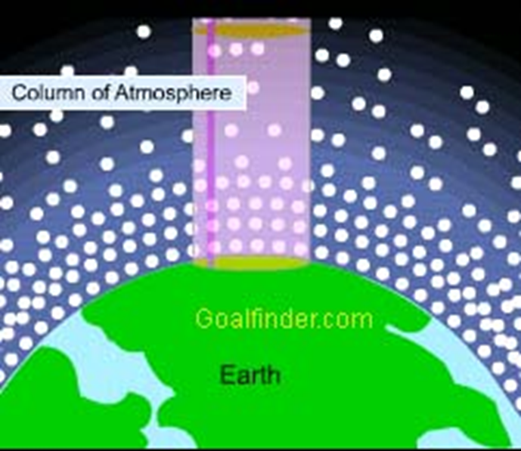
Air Pressure and Density are Related!
Both air pressure and density decrease as you move higher in the atmosphere.
So the air at sea level is not only more dense, but also has higher air pressure.
*Air Molecules are pushed closer together at sea level which makes it more dense.

Slide 6
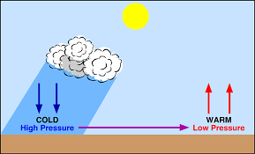
Air Pressure and Motion
However, air pressure can also vary within the same altitude.
The differences in air pressure cause air to move. Air moves from areas of high air pressure to areas of low air pressure.
Without varying air pressure air would not move!!

Slide 7
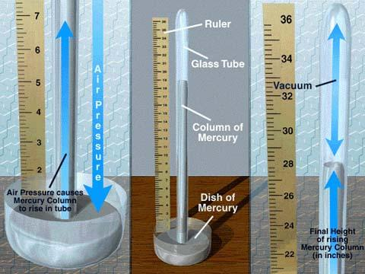
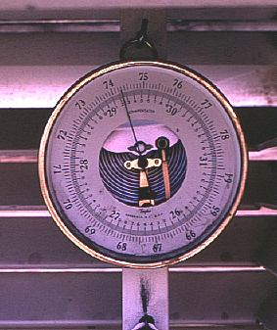
Barometer
The piece of equipment used to measure air pressure is a Barometer
Aneroid Barometer
Mercury Barometer

Slide 8
Barometer Video
https://www.youtube.com/watch?v=EkDhlzA-lwI&t=33s

